Slide 1
Arabic Text Summarization
Deep Learning Approach using Seq2Seq

Slide 2







Linguistic Challenges
Morphological Richness
Dialectal Variance
Abstractive Tasks
Arabic is highly inflectional with complex root-pattern structures, making vocabulary size and word forms a significant challenge for NLP models.
The transition between Modern Standard Arabic (MSA) and various dialects (like Egyptian) requires robust cross-dialectal understanding.
Moving beyond simple extraction to "abstractive" generation requires the model to paraphrase and synthesize new sentences accurately.

Slide 3
Core Project Objectives
Dataset Consolidation: Merge four diverse Arabic news corpora into a single unified training environment.
Architecture Design: Build a custom Seq2Seq model using Bidirectional LSTM and Bahdanau Attention from scratch.
Preprocessing Pipeline: Implement rigorous text cleaning and AraBART-based tokenization for Arabic script.
Performance Tuning: Utilize teacher forcing, gradient clipping, and early stopping to optimize ROUGE metrics.

Slide 4
Multi-Source Datasets
Dataset Name | Format | Content Description
SumArabic 1.0 | JSONL | MSA news articles and headlines
AraSum | TSV | Large corpus for abstractive summaries
Egyptian News | Parquet | Moderate size featuring Egyptian dialect
Arabic Kaggle | CSV | General news summarization data
Final merged training set size: 46,911 high-quality article-headline pairs.

Slide 5


Data Standardization
Cleaning: Collapsed whitespace, removed Latin chars and guillemets (»«).
Noise Removal: Stripped Unicode control characters and parenthetical numbers.
Normalization: Standardized punctuation (ellipses to periods, % symbols).
Dialect Handling: Standardized text and target column headers for consistency.

Slide 6

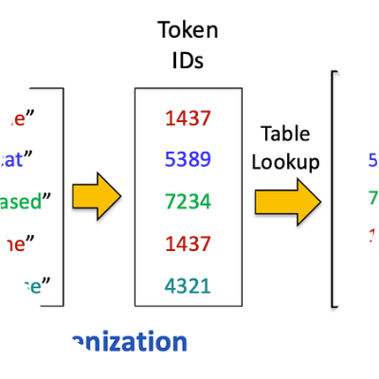

AraBART Tokenization
SentencePiece Encoding
We used the moussakam/AraBART tokenizer from Hugging Face, specifically designed for the morphological nuances of Arabic.
Max Source Length: 1,024 tokens
Max Target Length: 256 tokens
Training Caps: 256 (Encoder) / 128 (Decoder)

Slide 7






Bidirectional Encoder
Bi-LSTM Layers
Embeddings
Hidden State
Processes text in both forward and backward directions to capture context from the whole sentence.
256-dimensional embedding layer converting token IDs into dense semantic vectors.
512 hidden units per direction, resulting in a 1024-dimensional combined context for the decoder.

Slide 8
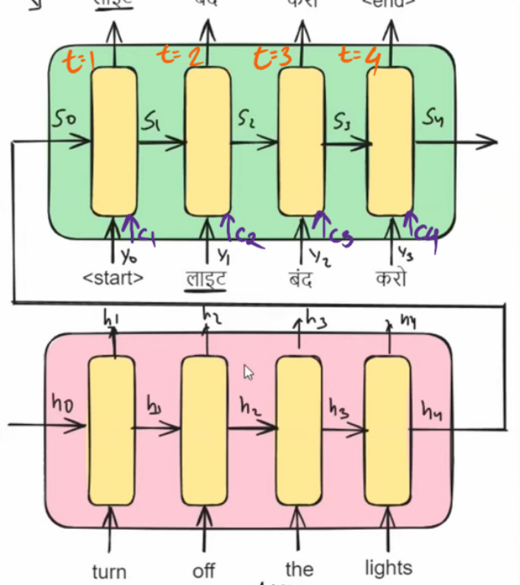
Bahdanau Attention
The decoder focuses on specific encoder parts at each generation step, calculating a dynamic context vector.

Slide 9
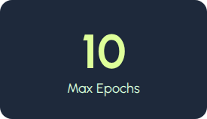
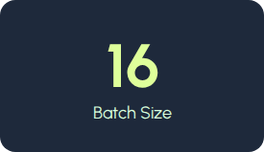
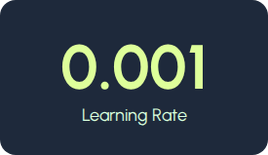
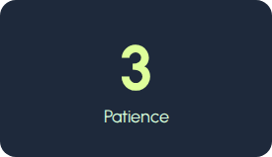

Model Hyperparameters
Optimization: Adam Optimizer with CrossEntropyLoss (ignoring padding). Teacher Forcing implemented to stabilize early training phases by providing actual ground-truth summaries as inputs to the decoder.

Slide 10
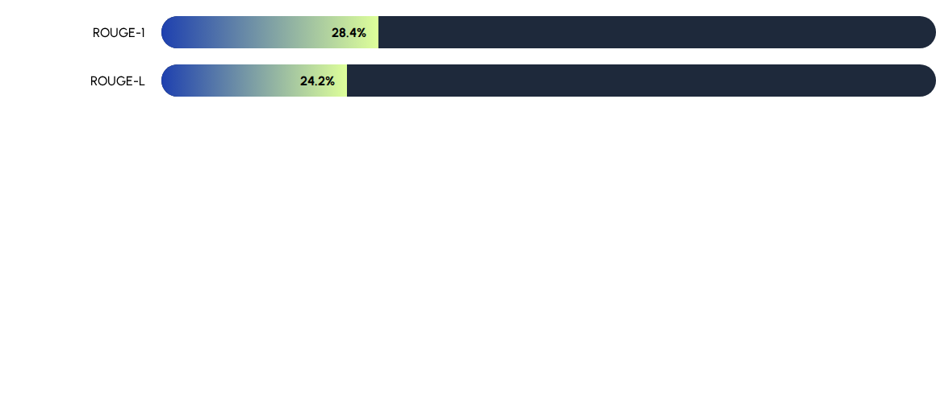

Performance Metrics
Results computed on decoded Arabic text rather than token IDs. This ensures that linguistic quality, rather than just sequence overlap, is captured in the evaluation. ROUGE scores reflect initial abstractive capabilities built from scratch.

Slide 11
System Limitations
Truncation Loss: Long articles shortened to 256 tokens might lose deep context from the conclusion.
No Pre-training: Weights were initialized from scratch rather than fine-tuning massive models like AraBART.
Decoding Strategy: Current implementation uses Greedy Decoding; more complex outputs could benefit from Beam Search.
Dialectal Noise: Mixed MSA and Egyptian text occasionally confused the semantic consistency.

Slide 12
Conclusion & QA
Next Step: Fine-tuning pre-trained AraBART for SOTA results.
Search: Implementation of Beam Search (Width 4-8).
Mechanism: Adding Pointer-Generator networks to handle OOV names.
Thank you for your attention!

